Slide 1




1.5 mya - Present
Chapter 33
PATTERNS OF CHANGE IN TECHNOLOGY
patterns of change in technology
Strand Two & Three: The History of the World
@MsDoorley

Slide 2







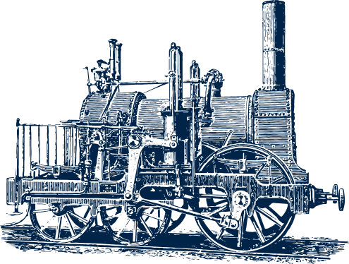




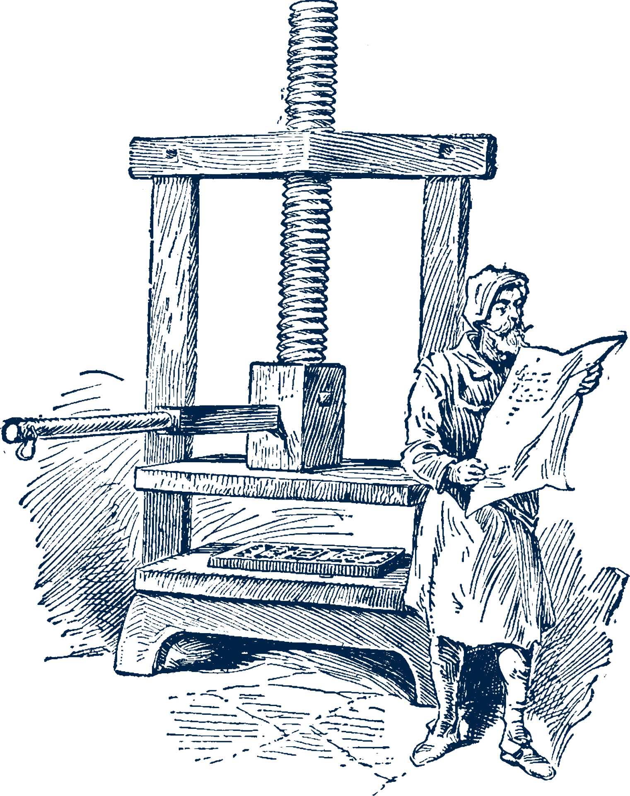


Chapter 33
PATTERNS OF CHANGE:
TECHNOLOGY
Gunpowder - Alchemists in China invented gunpowder
Steam Engine - James Watt improved the Newcomen Steam Engine.
Atomic Bomb - first used by the USA to force Japan to stop the war
1.5 mya
850
1455
1825
1886
1945
1957
Strand Two & Three: The History of the World
Chapter Thirty-Three: Patterns of Change in Technology
Evidence found of controlled use of fire by Homo erectus in Africa.
Printing Press - Johannes Gutenberg created the moveable printing press.
Automobiles - first cars were developed by Karl Benz in Germany.
Spaceflight - The Soviet Union launches the first satellite
@MsDoorley

Slide 3
Learning Outcomes
3.11 EXPLORE the contribution of technological developments and innovation to historical change.
Strand Two & Three: The History of the World
Chapter Thirty-Three: Patterns of Change in Technology
@MsDoorley

Slide 4
Introduction
Technology is the tools, devices or means used to carry out tasks. Innovation is any new idea, method or product that brings about change. Over the course of human history, developments in technology have been among the most important drivers of change. In this chapter, we will look at the factors that led to technological innovations, the innovations themselves and the impact they had on people's lives and on the history of the world.
Strand Two & Three: The History of the World
Chapter Thirty-Three: Patterns of Change in Technology
@MsDoorley

Slide 5
1.5 mya - Present
Chapter 33
33.1: TECHNOLOGY IN ANCIENT TIMES
33.1: technology in ancient times
Strand Two & Three: The History of the World
@MsDoorley

Slide 6
Agricultural Innovation - Prehistoric to Ancient
The goal of a secure and nutritious food supply has shaped how we have lived our lives since the Stone Age. Farming was a transformational technology that allowed the expansion of human populations and created settlements, leading to the emergence of civilisation.
Our earliest ancestors, people of the Mesolithic Period, were hunter-gatherers; they hunted wild animals and gathered plants to feed themselves. They were nomadic; they moved from one area to another with the seasons or as the food supply ran low. The first settlements began with the Neolithic farmers, of whom we have we have evidence of the cultivation of grasses and crops which was the first sign of farming alongside the domestication of animals. These animals could be killed for meat or kept to produce diary products such as milk and cheese, which became central to most human diets.
With a secure food supply, people were able to settle in one place and form communities. Over time, these grew into towns and cities. With a food surplus, not everyone would have to farm; some people could focus on things such as metalworking, carpentry, cloth making or religious practice.
As the crafting of metal for tools and weapons improved, so did farming. For example, iron ploughs were stronger; they allowed the soil to be ploughed more deeply and enabled the cultivation of heavier soils. Water supply systems for bringing drinking water to ancient cities were also used to irrigate fields and keep soils fertile.
Strand Two & Three: The History of the World
Chapter Thirty-Three: Patterns of Change in Technology
@MsDoorley

Slide 7
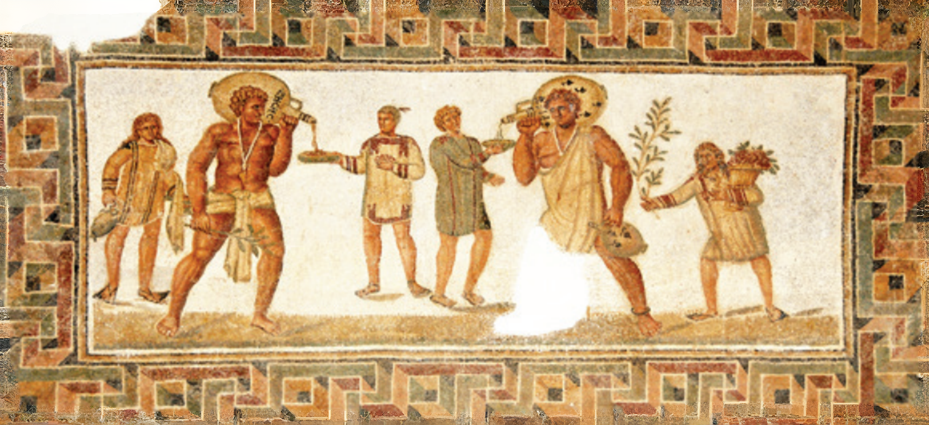
Strand Two & Three: The History of the World
Chapter Thirty-Three: Patterns of Change in Technology
Diagram taken from Artefact, 2nd Edition by Eimear Jenkinson and Gregg O'Neill (educate.ie)
@MsDoorley

Slide 8
Manufacturing and Industry
The manufacture of objects (tools, weapons, pots, homes, clothes, etc.) has been part of human existence since our earliest times. Beginning with stone and wood and then moving on to different types of metals, humans have created the objects the need to survive.
For example, as civilisation grew on the island of Ireland, the Bronze Age brought with it the first use of metal to the island.
Bronze (an alloy (combination) of copper and tin) was stronger than stone but was also much easier to shape so people had greater control over the tools and weapons they could make.
Copper was mined at Mount Gabriel in Co. Cork but tin had to be imported from the likes of Cornwall in Britain.
Bronze was made by the process of smelting copper and tin – melting metal at a high temperature to separate it from the ore – combining them and pouring them into moulds to set.
Metalworkers (smiths) made tools such as sickles (to cut crops), axes and ploughs and weapons such as knives, swords, shields and spears while farming remained the main source of food for Bronze Age people.
Strand Two & Three: The History of the World
Chapter Thirty-Three: Patterns of Change in Technology
@MsDoorley

Slide 9
Military Technology
Conflict and violence have been a part of human existence since earliest times. From the earliest times of human civilisation, warriors used swords, daggers and spears in close combat. They wore armour and carried shields to defend themselves from their opponents' weapons.
To strike enemies who were father away, throwing weapons such as spears, bows and arrows, and crossbows were developed. These weapons were initially made of stone and wood, then over time different types of metals replaced the stone components.
As more people began to live in or close to fortified settlements (with high and thick walls for protection), siege weapons were developed to attack them. The Romans were especially innovative at this and developed machines such as catapults and other weapons that could launch projectiles (such as large stones or metal balls) at enemy cities to break through their walls.
These innovations, as well as their mastery of battlefield tactics and use of iron weapons, allowed the Romans to conquer and control a vast empire around the Mediterranean for centuries.
Strand Two & Three: The History of the World
Chapter Thirty-Three: Patterns of Change in Technology
@MsDoorley

Slide 10
Questions Pg 406 (Artefact, 2nd Edition)
  How did the cultivation of crops and domestication of animals affect human history?
Strand Two & Three: The History of the World
Chapter Thirty-Three: Patterns of Change in Technology
@MsDoorley

Slide 11
1.5 mya - Present
Chapter 33
33.2: TECHNOLOGY IN THE MIDDLE AGES
33.2: technology in the middle ages
Strand Two & Three: The History of the World
@MsDoorley

Slide 12
Agricultural Innovation
Medieval farming on the feudal manor had developed into the open field system of farming:
The land for crops was divided into three huge fields. Each field was divided into long strips of land and tended by different families. Each family had strips in each of the three fields.
They practised crop rotation – the crop in each field was changed every year. For example:
  Field One – wheat for making bread
  Field Two – oats for making porridge, barley for making beer
  Field Three was left fallow (empty) for one year so that the soil could recover its nutrients.
  A fourth large field, called The Commons, was used for animal grazing.
These practices remained inefficient, as they left one-third of the land empty.
Strand Two & Three: The History of the World
Chapter Thirty-Three: Patterns of Change in Technology
 | Field 1 | Field 2 | Field 3
Year 1 | Wheat | Oats and Barley | Fallow
Year 2 | Oats and Barley | Fallow | Wheat
Year 3 | Fallow | Wheat | Oats and Barley
@MsDoorley

Slide 13
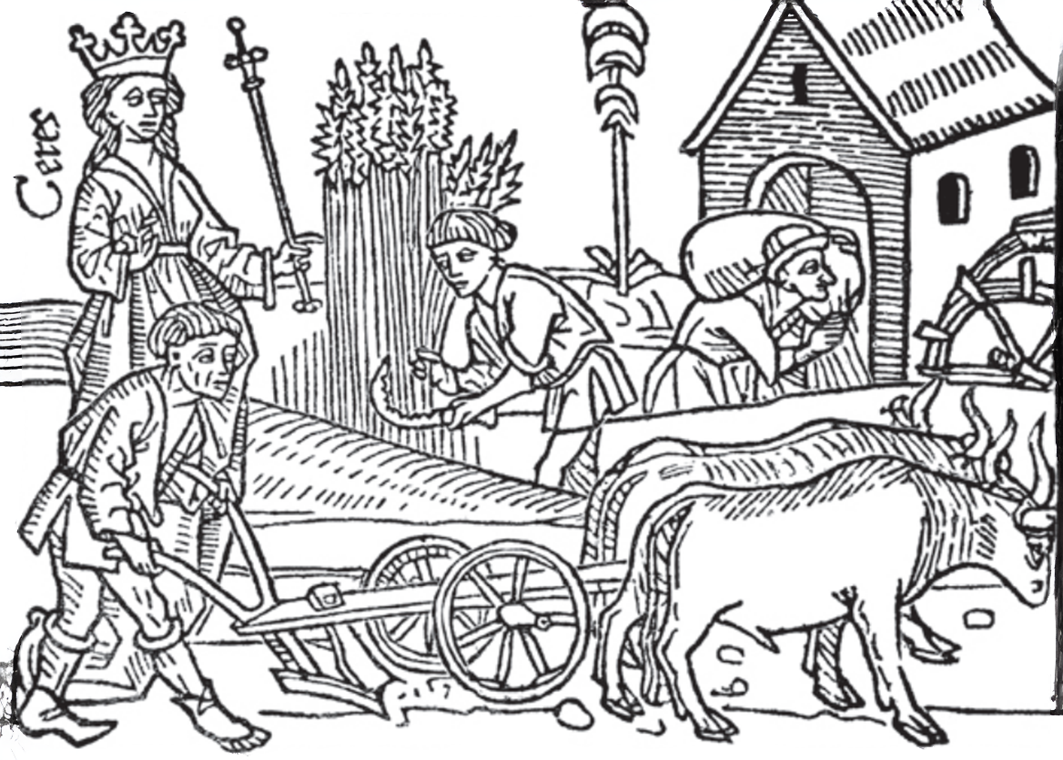
Strand Two & Three: The History of the World
Chapter Thirty-Three: Patterns of Change in Technology
Diagram taken from Artefact, 2nd Edition by Eimear Jenkinson and Gregg O'Neill (educate.ie)
@MsDoorley

Slide 14
Manufacturing and Industry
The Middle Ages saw the innovation of blast furnaces in Europe - several centuries after they had been invented in China; am example of the same technological advances happening in different places at different times.
Blast furnaces produced better quality (purified) iron. More importantly, they also produced molten (hot liquid) iron, which could be poured into moulds, resulting in cast-iron tools and weapons. Until then, each tool or weapon had to be individually hammered into shape. This meant that higher quality iron implements became widespread.
Strand Two & Three: The History of the World
Chapter Thirty-Three: Patterns of Change in Technology
@MsDoorley

Slide 15
Military Technology
An average Roman legionary soldier would have found the weaponry of an average Norman knight from the Middle Ages very familiar. Like the Romans, knights used swords, wore plate armour and carried large shields.
The knowledge of the process of making steel was imported from Chinese trade routes during the Middle Ages. Steel is harder and more durable than iron. It was difficult to make and only wealthiest knights would have had steel weapons and armour.
Strand Two & Three: The History of the World
Chapter Thirty-Three: Patterns of Change in Technology
@MsDoorley

Slide 16
Questions Pg 406 (Artefact, 2nd Edition)
  What were the most common weapons in the Middle Ages?
  How did the use of metal benefit agriculture?
  Why did farming lead to mass enslavement?
  What was crop rotation?
Strand Two & Three: The History of the World
Chapter Thirty-Three: Patterns of Change in Technology
@MsDoorley

Slide 17
1.5 mya - Present
Chapter 33
33.3: TECHNOLGY DURING THE RENAISSANCE
33.3: technolgy during the renaissance
Strand Two & Three: The History of the World
@MsDoorley

Slide 18
Military Technology
The invention of gunpowder is an excellent example of innovation by accident. In the 800s, Chinese doctors were looking for ways to extend life when they mixed sulphur with saltpetre, which produced an explosive reaction. This was the most important military technological innovation of the last millennium: gunpowder. Gunpowder had reached Europe by the 1300s. Records show gunpowder being made in the Tower of London in 1346.
The use of gunpowder completely changed warfare. The invention of the largescale cannon that could fire huge projectiles (usually rounded metal balls) eventually made city and castle walls useless as well as transforming naval battles by allowing ships to easily sunk from a distance. Handheld guns evolved over the following centuries. Battles became significantly bloodier, with much higher rates of injury and death.
Much of the innovation in the use of guns happened in Europe; this allowed Europeans to easily conquer parts of the world that did not possess this technology. For example, the Spanish conquest of the Aztecs and Incas in South American was aided by their guns and steel, while the indigenous peoples only had copper and stone weapons.
Strand Two & Three: The History of the World
Chapter Thirty-Three: Patterns of Change in Technology
@MsDoorley

Slide 19
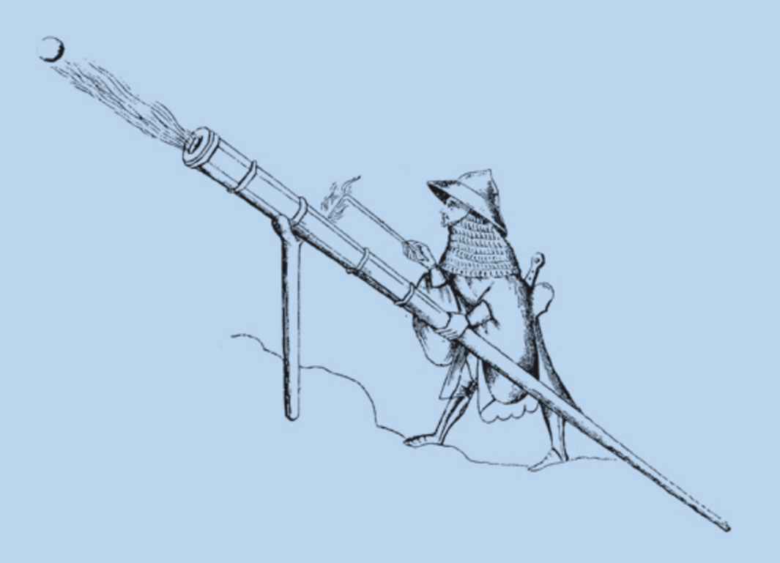
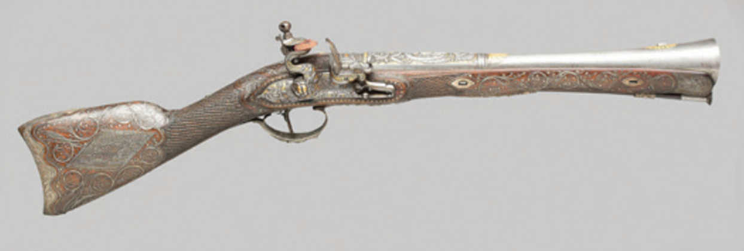
Strand Two & Three: The History of the World
Chapter Thirty-Three: Patterns of Change in Technology
Diagram taken from Artefact, 2nd Edition by Eimear Jenkinson and Gregg O'Neill (educate.ie)
@MsDoorley

Slide 20
Communication Technology
Before the 1400s in Europe, books had to be handwritten (manuscripts). Not many books were in circulation due to being time consuming and expensive, making them very precious. Johannes Gutenberg, a German goldsmith, is accredited with the invention of the moveable type printing press. The process involved placing individual metal letters into a frame to form words, coating them with ink and pressing the frame onto paper. The letters could then be rearranged in the frame for the next page. The first book Gutenberg printed was the Gutenberg Bible. Gutenberg’s invention spread quickly. By 1500, printing presses were operating in every major European city.
Printed books were far cheaper and quicker to produce than manuscripts. More people learned to read and write (became literate). This also meant people read more and were introduced to new ideas. Fiction became popular as people began to read for entertainment. The Catholic Church’s control over learning and ideas declined. People who challenged the Church could spread their ideas quickly and widely. This would be key to The Reformation. The use of Latin declined as books were published in the vernacular (the language as spoken by people in their native country). The invention of the moveable type printing press was the single most important factor in the spread of the Renaissance throughout Europe.
Strand Two & Three: The History of the World
Chapter Thirty-Three: Patterns of Change in Technology
@MsDoorley

Slide 21
Navigational Technology
Before the Age of Exploration, sailors stayed close to the shoreline. Advances in technology made navigation easier and made it possible for ships to sail out into the ocean to explore. Cartographers started using more detailed maps from Constantinople. The Portuguese developed portolan charts, which mapped coastlines and harbours more accurately and also recorded currents, tides and depth. Maps were regularly updated by returning explorers. Specific innovations include:
  A quadrant and an astrolabe were used to determine a ship’s latitude (the distance from the equator) by the position of the stars and the sun.
  A compass used magnetism to locate north and identify the direction of travel.
  A log and line was used to measure a ship’s speed in knots.
  A line and lead weight was used to measure the depth of the water and ensure it was not too shallow for the ship. The captain recorded all of this information regularly in a logbook.
Strand Two & Three: The History of the World
Chapter Thirty-Three: Patterns of Change in Technology
@MsDoorley

Slide 22
Impact and Contribution to Historical Change
The new instruments allowed sailors to work out exactly where they were, based on how far they had travelled and how fast, their distance from the equator and the direction of travel. Combined with new and improved maps and ships that were stronger and far more easily managed, these advances made long voyages safer and enabled Europeans to explore unknown regions. The voyages of exploration, European conquest and colonisation of the Americas and the wider world, the Colombian exchange and the Atlantic slavery triangle all depended on the advances.
Strand Two & Three: The History of the World
Chapter Thirty-Three: Patterns of Change in Technology
@MsDoorley

Slide 23
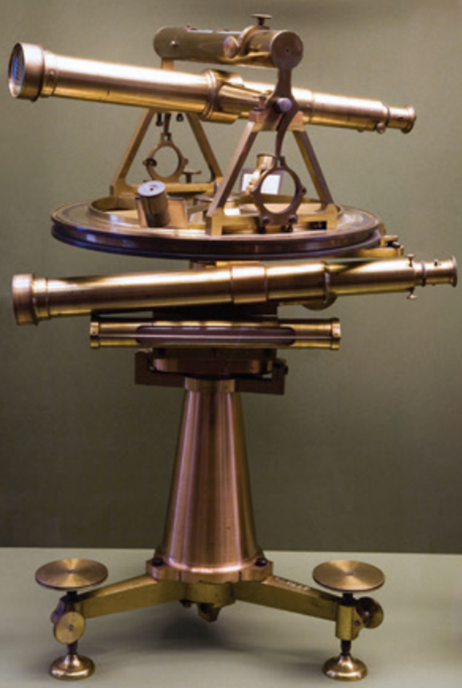
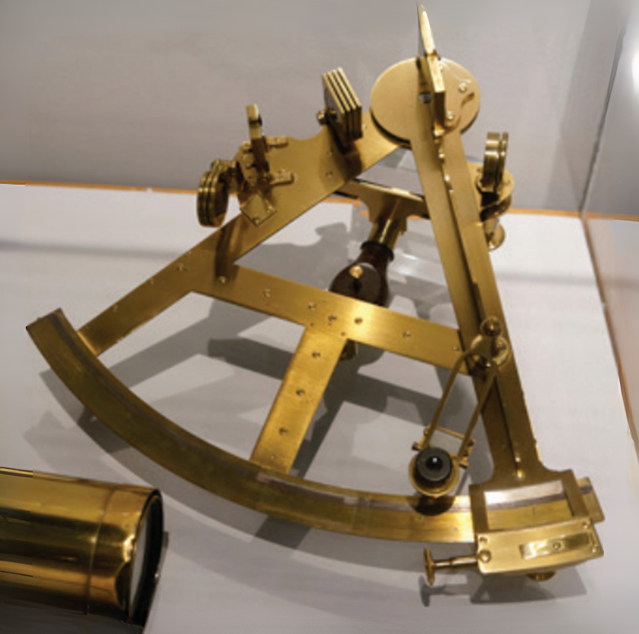
Strand Two & Three: The History of the World
Chapter Thirty-Three: Patterns of Change in Technology
Diagram taken from Artefact, 2nd Edition by Eimear Jenkinson and Gregg O'Neill (educate.ie)
@MsDoorley

Slide 24
Questions Pg 406 (Artefact, 2nd Edition)
  What were the most common weapons during the Renaissance era?
  Where did gunpowder originate?
  How did gunpowder change warfare?
  Who invented the movable type printing press and when?
  How did the printing press contribute to changes in European societies?
  How did the School of Navigation help technological innovation?
  Name and explain one of the navigational instruments that helped European ships during the Age of Exploration.
  What innovations in ship building can be seen in the fifteenth century?
Strand Two & Three: The History of the World
Chapter Thirty-Three: Patterns of Change in Technology
@MsDoorley

Slide 25
1.5 mya - Present
Chapter 33
33.4: TECHNOLGY IN INDUSTRIAL SOCIETY
33.4: technolgy in industrial society
Strand Two & Three: The History of the World
@MsDoorley

Slide 26
Agricultural Innovation
The period from 1751 to 1901 saw huge changes across Europe, particularly in Britain. The population soared from 5 million in 1751 to 8 million in 1801 to 16 million in 1851 and 30 million in 1901. Significant changes in technology was needed to support this population.
Charles Townshend's Norfolk system involved a four-crop rotation cycle of wheat, turnips, oats/barley and clover/grass over four years. Instead of leaving a field fallow every year, the important nutrients could be returned to the soil by growing turnips, clover or grass. Each crop could feed humans, animals or both.
Landlords began to insist that their tenants practise an older method called enclosure: each tenant farmer's fields were grouped together in one small farm, fenced off, instead of in strips all across the landlord's land.
Robert Bakewell developed a method known as selective breeding; reserving the largest or most suitable animals for breeding rather than for meat. Larger and healthier animals were bred and meat became more widely available.
Jethro Tull invented the seed drill - a machine, pulled by a horse or an ox, that sowed seeds at the right depth and in straight rows. Before this, seeds were scattered by hand and many were wasted. This new method made sowing more efficient.
Cyrus McCormick invented a mechanical reaper. This was a horse-drawn cart with a cutting blade that cut crops neatly in straight rows. Crop harvesting became faster and cheaper.
Strand Two & Three: The History of the World
Chapter Thirty-Three: Patterns of Change in Technology
@MsDoorley

Slide 27


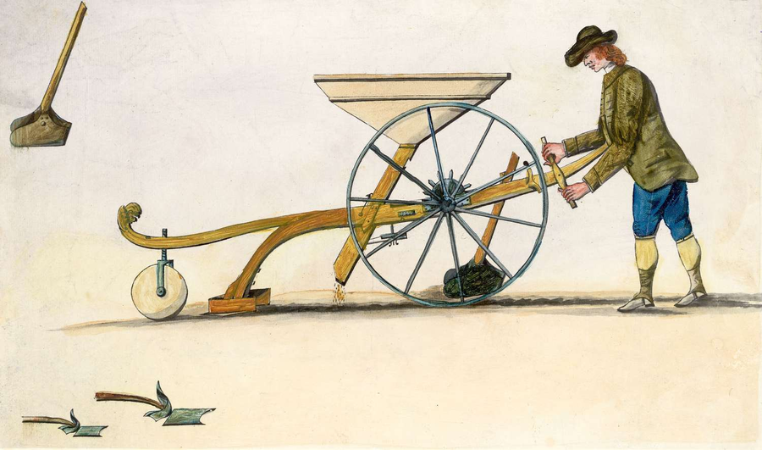
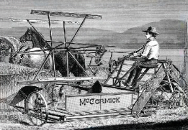
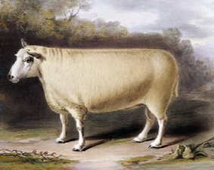
Strand Two & Three: The History of the World
Chapter Thirty-Three: Patterns of Change in Technology
Diagram taken from Artefact, 2nd Edition by Eimear Jenkinson and Gregg O'Neill (educate.ie)
@MsDoorley

Slide 28
Manufacturing and Industry
There were many causes of the Industrial Revolution which began in Britain in the middle of the 18th Century. One of the most important causes was the invention of the steam engine.
The steam engine contributed to huge historical change in the 18th and 19th centuries.
Steam engines built by Thomas Newcomen were first used to pump water out of mines with James Watt making improvements to the early steam engines. His most important improvement was the addition of a flywheel. The old steam engines had only an up-and-down motion (movement). Watt’s engine had a rotary (turning) motion.
Now steam engines could be used to power other machines, allowing steam engines to power factories. The steam engine was used to power new inventions for making thread and cloth, such as Crompton’s spinning mule or Cartwright’s power loom. These inventions speeded up the manufacture of cloth. The new machines were also bigger than the old spinning wheel and hand loom and were powered by water wheels (and later by steam engines). This meant that they could only be used in mills and factories rather than houses. This led to the growth of factories in cities in Britain.
Strand Two & Three: The History of the World
Chapter Thirty-Three: Patterns of Change in Technology
@MsDoorley

Slide 29
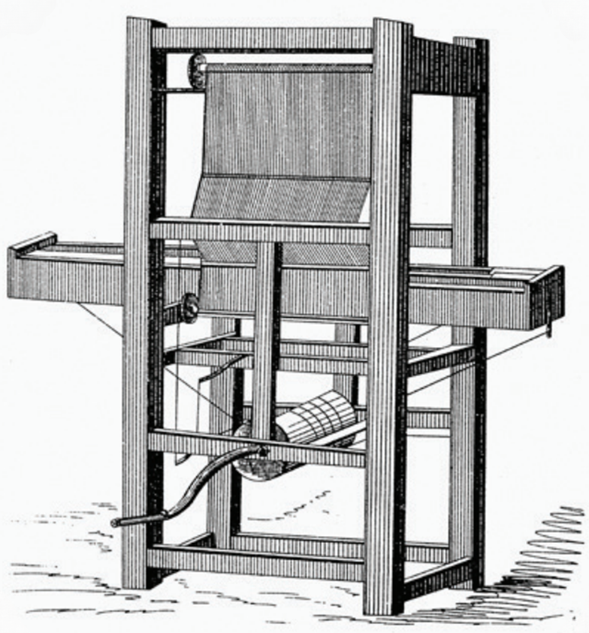
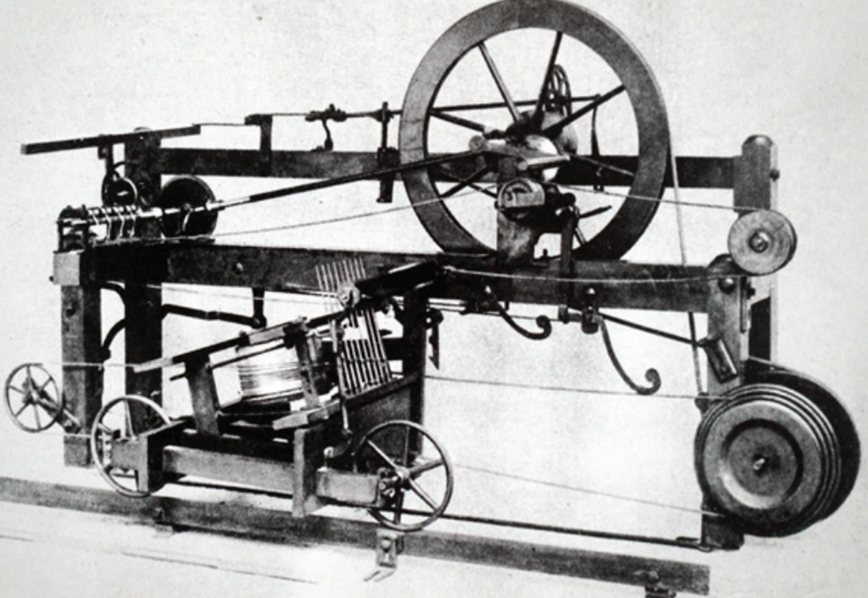
Strand Two & Three: The History of the World
Chapter Thirty-Three: Patterns of Change in Technology
Diagram taken from Artefact, 2nd Edition by Eimear Jenkinson and Gregg O'Neill (educate.ie)
@MsDoorley

Slide 30
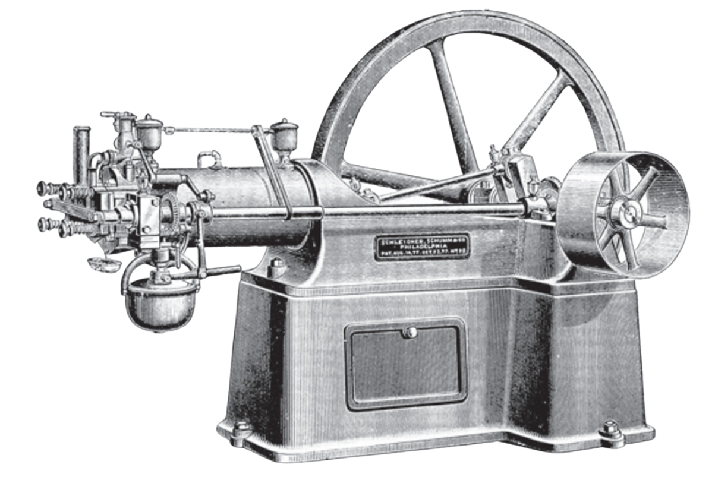
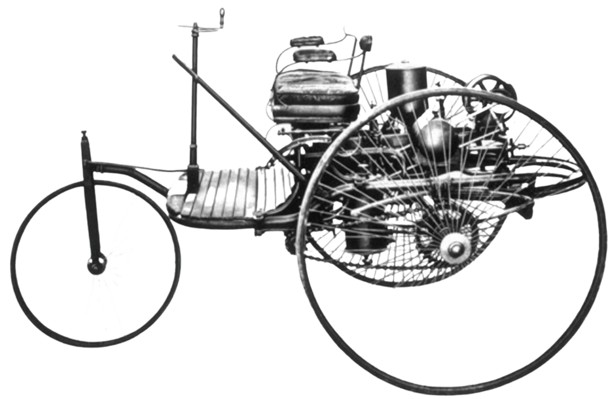
Strand Two & Three: The History of the World
Chapter Thirty-Three: Patterns of Change in Technology
Diagram taken from Artefact, 2nd Edition by Eimear Jenkinson and Gregg O'Neill (educate.ie)
@MsDoorley

Slide 31
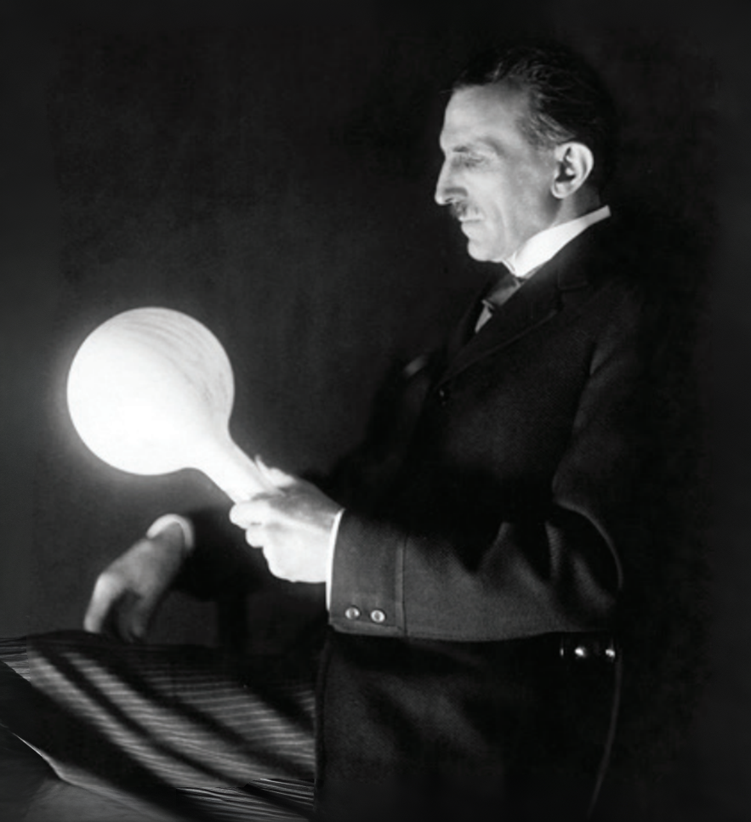
Strand Two & Three: The History of the World
Chapter Thirty-Three: Patterns of Change in Technology
Diagram taken from Artefact, 2nd Edition by Eimear Jenkinson and Gregg O'Neill (educate.ie)
@MsDoorley

Slide 32
Communication Technology
Friedrich Koenig invented the steam-powered printing press in 1812. This press could print 1,100 sheets per hour and could print on both sides of the page. The Koenig press is a very good example of cross-innovation in technology, where developments in one area (such as steam power) can change another another area (printing).
The major impact of the Koenig and later steam-powered presses was the growth of mass media, as newspapers could now be produced in much larger quantities, more quickly and with more pages.
Further innovations in printing followed. For example, colour printing became more common by the end of the nineteenth century, though still very expensive.
Strand Two & Three: The History of the World
Chapter Thirty-Three: Patterns of Change in Technology
@MsDoorley

Slide 33
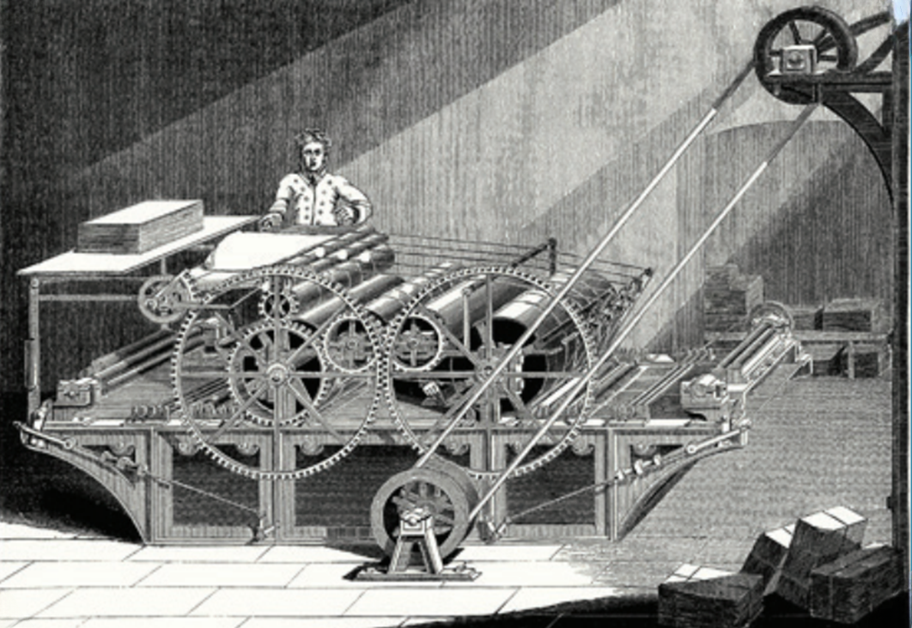
Strand Two & Three: The History of the World
Chapter Thirty-Three: Patterns of Change in Technology
Diagram taken from Artefact, 2nd Edition by Eimear Jenkinson and Gregg O'Neill (educate.ie)
@MsDoorley

Slide 34
Navigational Technology
The invention of the steam engine speeded up the transport revolution. Britain depended on carts and canals for transporting goods; the development of the railways changed all that. The first railways were built to haul coal from coal mines but these railroads used huge stationary steam engines. When Richard Trevithick designed a small engine on wheels, the Railways Age had begun. In 1825, the first goods train ran between Stockton and Darlington, built by George Stephenson. The first passenger line was built between Manchester and Liverpool – George and Robert Stephenson’s Rocket ran this line.
Strand Two & Three: The History of the World
Chapter Thirty-Three: Patterns of Change in Technology
@MsDoorley

Slide 35
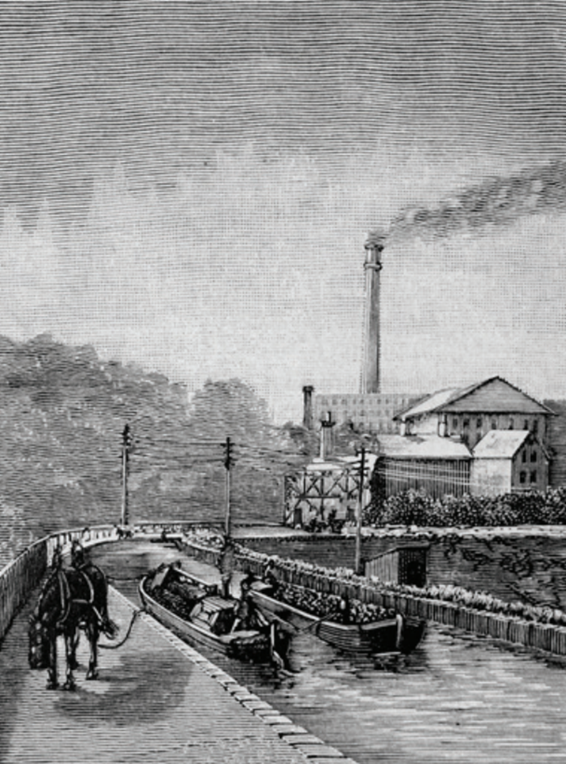
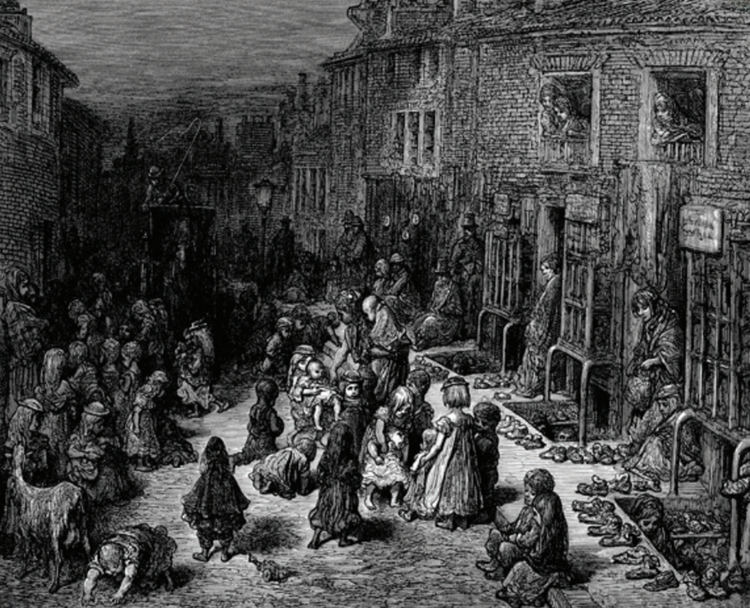
Strand Two & Three: The History of the World
Chapter Thirty-Three: Patterns of Change in Technology
Diagram taken from Artefact, 2nd Edition by Eimear Jenkinson and Gregg O'Neill (educate.ie)
@MsDoorley

Slide 36
Technological Inventions
  1705– Steam Engine – used to pump water out of mines, invented by Thomas Newcomen
  1709– Coke– coal without gasses, discovered by Abraham Darby
  1733– Flying Shuttle – help speed up weaving, invented by John Kay
  1763– Rotary Steam engine – improved the steam engine so it could be transported and used outside the mines, invented by James Watt, while a unit of measurement was named after him.
  1764– Spinning Jenny – help speed up spinners, invented by James Hargreaves
  1769 – Water Frame – spinning machine powered by water, invented by Richard Arkwright
  1779 – Mule – combined the Spinning Jenny and Water Frame, invented by Samuel Crompton
  1784 – Ruddling and Rolling – created wrought iron (strong), invented by Henry Cort
  1785 – Power Loom – new weaving process – invented by Edmund Cartwright
  1856 – The Bessemer Converter – vassal for making steel
Strand Two & Three: The History of the World
Chapter Thirty-Three: Patterns of Change in Technology
@MsDoorley

Slide 37
Questions Pg 406 (Artefact, 2nd Edition)
  What is cross-innovation and how did it impact on printing?
  What innovations in ship building can be seen in the nineteenth century?
  Name and explain one innovation from the Agricultural Revolution.
  What is the link between the Agricultural and Industrial Revolutions?
  How was the production of cloth increased in the eighteenth century?
  Why was the invention of the steam engine important?
  What invention from the Industrial Revolution do you think was the most important? Give reasons for your answer.
  Describe life in industrial Britain.
Strand Two & Three: The History of the World
Chapter Thirty-Three: Patterns of Change in Technology
@MsDoorley

Slide 38
1.5 mya - Present
Chapter 33
33.5: TECHNOLGY IN THE TWENTIETH CENTURY
33.5: technology in the twentieth century
Strand Two & Three: The History of the World
@MsDoorley

Slide 39
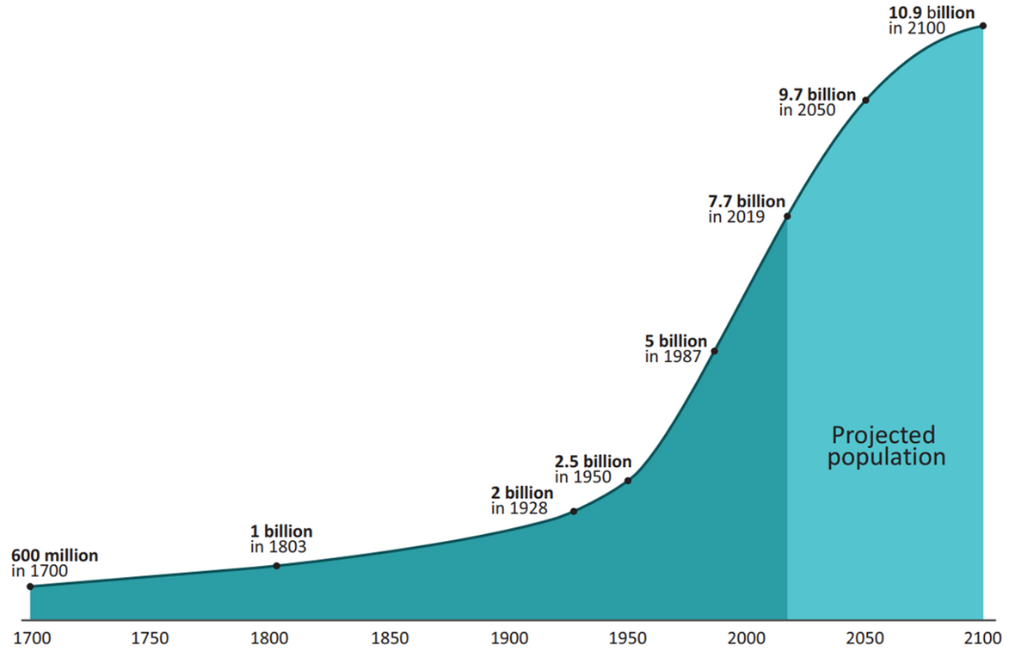
Agricultural Innovation
Historians estimate that the global population in 1700 was 600 million. This grew to 1 billion in 1800 and reached 2 billion by 1930. On 15 November 2022, the world reached 8 billion. This population explosion meant that more food was needed to be produced.
Strand Two & Three: The History of the World
Chapter Thirty-Three: Patterns of Change in Technology
Diagram taken from Artefact, 2nd Edition by Eimear Jenkinson and Gregg O'Neill (educate.ie)
@MsDoorley

Slide 40
Agricultural Innovation
The invention of the internal combustion engine allowed machinery to take over farm work. Tractors and combine harvesters removed the need for working animals; the land that had been used to maintain these was freed up for food production. The technology also further reduced the level of human labour required.
Artificial fertilisers were developed early in the twentieth century to replace nitrogen in soil that was used up by crop growth. Fertilisers eliminated the need for crop rotation and allowed more than one crop to be grown in a single year.
Crop problems caused by insects, diseases and weeds can ruin an entire year's crop - as we saw with the Great Irish Famine. The use of chemicals in farming began in the 1920s with the development of a synthetic insecticide, Lethane 384. From then on, insecticides (for dealing with insects), fungicides (for plant diseases) and herbicides (to get rid of weeds) have been widely used and have significantly increased crop yields.
The introduction of these methods to the developing world after World War II became known as the Green Revolution.
With less manual labour needed on farms, more people moved to urban areas looking for work. In 1900, only about 200 million people lived in cities, about 10% of the global population. By 2000, this figure was 3 billion people - about 50% of the global population.
Until the Green Revolution, crop failures were regular occurrences, while famine and starvation were common.
The drive to produce more and more food has led to many now-controversial practices: factory farming and the use of chemicals on animals; the role of insecticides in killing off vital insect species and in causing health problems in consumers; and the role of industrial cattle farming in climate change.
Strand Two & Three: The History of the World
Chapter Thirty-Three: Patterns of Change in Technology
@MsDoorley

Slide 41
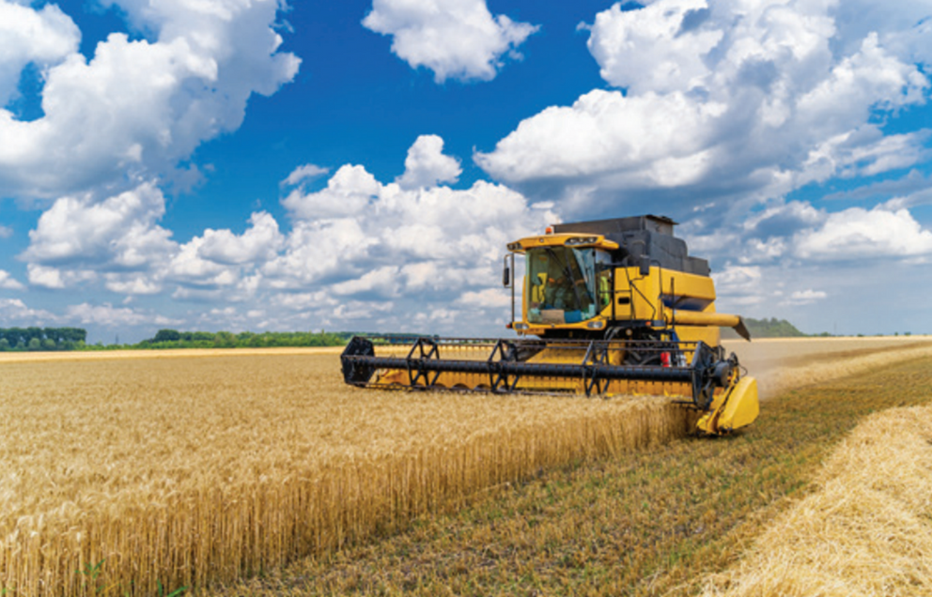

Strand Two & Three: The History of the World
Chapter Thirty-Three: Patterns of Change in Technology
Diagram taken from Artefact, 2nd Edition by Eimear Jenkinson and Gregg O'Neill (educate.ie)
@MsDoorley

Slide 42
Manufacturing and Industry
While huge strides had been made in the development of machinery throughout the nineteenth century, steam-powered machines were very large, difficult to use, labour-intensive and frequently malfunctioned. Many of these problems were overcome with the invention of the internal combustion engine.
Internal combustion engines use a liquid fuel accelerant (such as petrol or diesel) to drive their component gears, rather than relying on pressure generated by steam. These had numerous advantages over the earlier steam engines but most importantly they were much more compact and so could be used to power smaller, potentially mobile machines.
The first automobiles (cars) were developed by Karl Benz in Germany in 1886. In the USA, Henry Ford launched cars into mass production, developing the production assembly line so that factories could produce thousands of cars per day. His assembly process (whereby workers stayed in position and the 'line' brought the next machine to them to have its parts fitted) would be copied worldwide in machine production.
Internal combustion engines were used to drive electricity-generating power plants. These plants would provide electricity to homes and business over the course of the twentieth century.
Thomas Edison and Nikola Tesla developed the lightbulb in 1879. This used electricity to generate artifical light, making expensive sources of light such as candles and oil lamps unnecessary.
Strand Two & Three: The History of the World
Chapter Thirty-Three: Patterns of Change in Technology
@MsDoorley

Slide 43
Manufacturing and Industry
Personal vehicles allowed people to travel far beyond their homes on a regular basis.
Larger vehicles such as tractors further mechanised agriculture: buses provided mass public transport beyond train routes; tanks were first built in World War I and would become a standard part of military technology.
The availability of cheap, reliable and secure sources of power transformed people's lives. People could light their homes without burning wood or other fuels, city streets could be illuminated making them much safer and factories could be operated non-stop in shifts, massively increasing industrial output.
Strand Two & Three: The History of the World
Chapter Thirty-Three: Patterns of Change in Technology
@MsDoorley

Slide 44
World War I: A New Ear In Warfare
Between World War I and World War II, the involved parties (the Entente/Allies and the Axis/ Central Powers) created and refined new weapons and technology in their attempts to gain an advantage over their enemies.
World War I saw the introduction of new military technology, including the first use of aeroplanes for reconnaissance, aerial combat and bombing. German submarines (U-boats) attacked any ships (military or civilian) in enemy waters. The British invented the tank to try to break the stalemate on the Western Front.
World War I also saw the first use of chemical weapons:
  Phosgene – six times more deadly than chlorine gas. Responsible for 85% of chemical weapons fatalities during WWI. (slow acting poison)
  Chlorine Gas – first used 22 April 1915. A greenish-yellow cloud that smelled like bleach. Killed soldiers by asphyxiation.
  Mustard – caused severe blistering on it’s victims. Caused blindness (slow acting poison)
Within six months of fighting, medics observed a set of symptoms among the trenches that they called ‘shell shock’, now known as Post-Traumatic Stress Disorder (PTSD). Symptoms included: anxiety, nightmares, tremors, confusion, memory loss and sudden hearing/sight loss.
Strand Two & Three: The History of the World
Chapter Thirty-Three: Patterns of Change in Technology
@MsDoorley

Slide 45
World War II: Warfare becomes deadlier
Better submarines and torpedoes were developed. Research went into ASDIC (sonar) and radar technology to scan the oceans. Aircraft carriers were seagoing air bases with a flight deck. Aircraft could refuel and take off from there, which helped to control the seas. Germany developed many Panzer tanks. The heavily armoured Tiger tank weighed 54 tonnes, had a gun barrel diameter of 8.8 cm and had a top speed of 45 km/h. The Allies developed dummy tanks and amphibious tanks. Grenades, pistols, rifles and machine guns were also improved. The Germans invented a machine gun (the MG 42) that could fire 1,200 rounds in one minute. The British Hurricane and Spitfire aircraft had Rolls Royce engines. The B-29 Superfortress was a long-range bomber developed by the US in 1942. In 1944, Germany invented the first jet fighter, the Messerschmitt ME 262. German scientists invented long-range rockets. The V1 flew at speeds of 400 km/h, while the later V2 flew at supersonic speed, with a top speed of 5,760 km/h.
Strand Two & Three: The History of the World
Chapter Thirty-Three: Patterns of Change in Technology
@MsDoorley

Slide 46
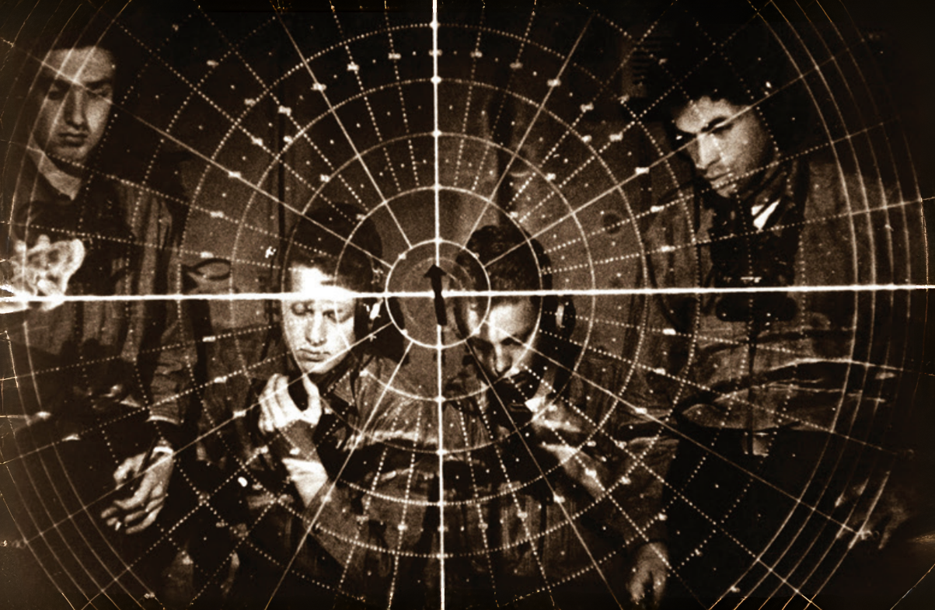
Strand Two & Three: The History of the World
Chapter Thirty-Three: Patterns of Change in Technology
Diagram taken from Artefact, 2nd Edition by Eimear Jenkinson and Gregg O'Neill (educate.ie)
@MsDoorley

Slide 47
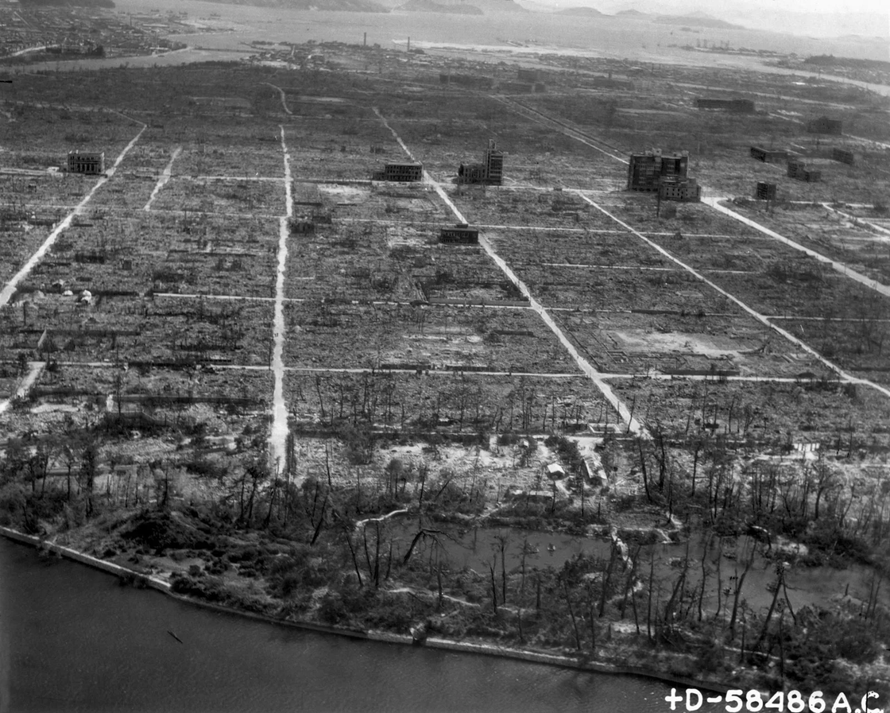
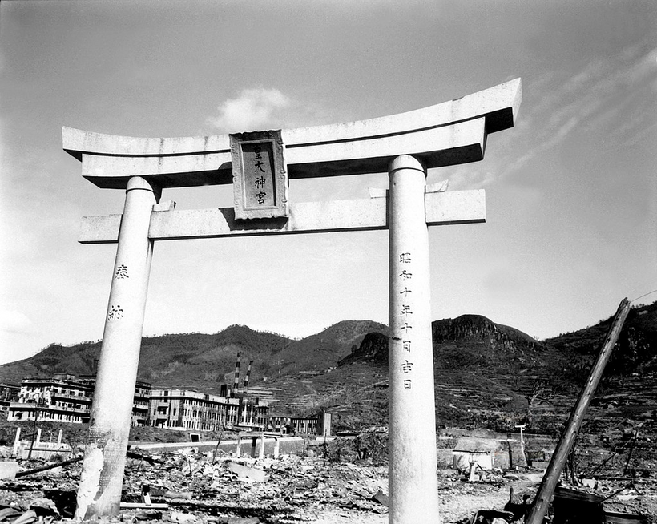
The Atomic Bomb
The US feared the Germans would be the first to develop the atomic bomb, so it began an intensive research programme codenamed the Manhattan Project, led by J. Roberts Oppenheimer, a Jewish nuclear physicist. The first working atomic bomb was tested in the New Mexico desert during the Trinity Test on the 16th July 1945. Less than a month later, the US Air Force, on the 6th August 1945 the first Atomic Bomb was dropped on the Japanese city of Hiroshima and three days later another was dropped on Nagasaki, killing 40,000 (thousands more would die later from radiation poisoning). In total, there were 129,000 civilians killed.
Strand Two & Three: The History of the World
Chapter Thirty-Three: Patterns of Change in Technology
Diagram taken from Artefact, 2nd Edition by Eimear Jenkinson and Gregg O'Neill (educate.ie)
@MsDoorley

Slide 48
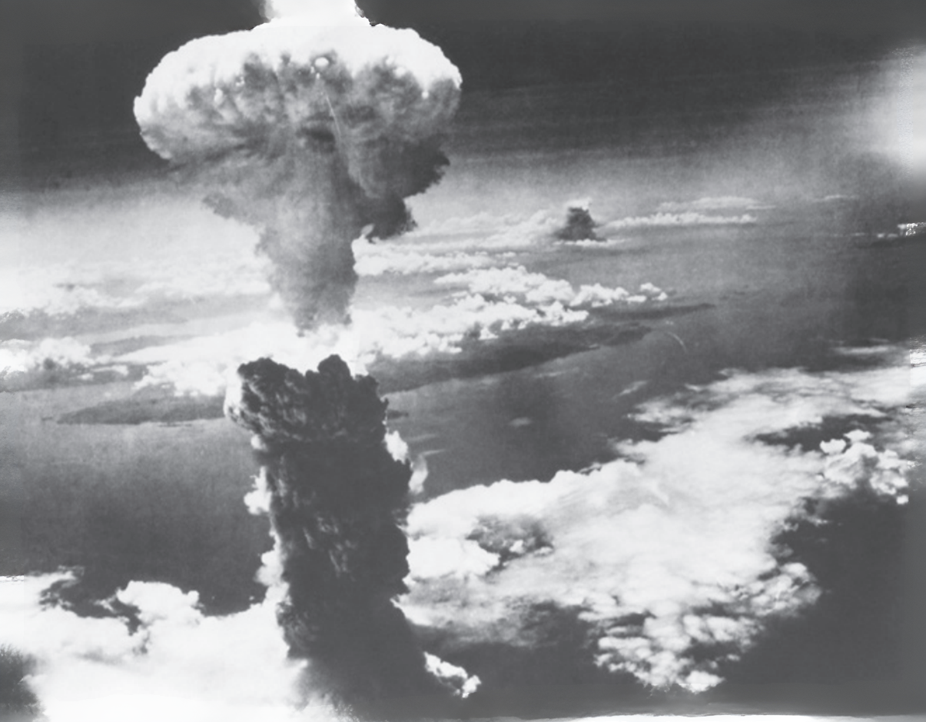
Strand Two & Three: The History of the World
Chapter Thirty-Three: Patterns of Change in Technology
Diagram taken from Artefact, 2nd Edition by Eimear Jenkinson and Gregg O'Neill (educate.ie)
@MsDoorley

Slide 49
Impact and Contribution to Historical Change
By the time of the events of World War II, fighting was no longer confined to particular areas as it had been in World War I. The new technology was highly mobile and so units and ‘fronts’ could move very quickly, as in the Blitzkrieg invasions of Poland and France. The destructive power of the new technology was far greater than ever before. In World War I, roughly 10 million soldiers while in World War II that roughly doubled to 15-20 million. War affected civilian populations in a way it had never before; it is estimated that 38-55 million civilians died during World War II while it is estimated it was 13 million civilians in World War I. Numerous cities were utterly destroyed, for example: Coventry (Britain), Dresden (Germany), Warsaw (Poland), Leningrad (Russia) and Hiroshima (Japan). The invention of the atomic bomb made it possible to obliterate large areas at the touch of a button. This threat would hang over both the US and the Soviet Union during the Cold War.
Strand Two & Three: The History of the World
Chapter Thirty-Three: Patterns of Change in Technology
@MsDoorley

Slide 50
Communication Technology
The nineteenth century saw the development of telecommunications: the sending and receiving of information using electronic means, which included wire, radio or any other electronic device. The combination of electricity and communication sparked a long series of innovations. Telecommunications were used for more than simply sharing information and connecting different places: entertainment also became a central function for communications.
Electric telegraph: Invented in 1831 by Joseph Henry, it used wires to transmit signals to be sent and received over long distances. Those signals could then be turned into text to communicate messages.
Telephone: The first telephone that could be practically used was developed by Alexander Graham Bell in 1876. It allowed two people to communicate verbally using devices that converted their voices into electronic waves sent along wires.
Radio: The first radio transmitters and receivers were developed in the 1890s by Guglielmo Marconi, and radio began to be used commercially around 1900. By the 1920s, nearly every home in Britain and the USA had a radio that gave people access to news, weather, music and other entertainment programmes.
Television: The idea of transmitting images over radio waves had been around since the late nineteenth century. The first television sets were developed in the 1920s. After World War II, television became the world's most common form of entertainment. By the mid-1950s, over 90% of US homes had a television set and most of the content they were watching was entertainment, not information.
Strand Two & Three: The History of the World
Chapter Thirty-Three: Patterns of Change in Technology
@MsDoorley

Slide 51
Impact and Contribution to Historical Change
Telegraphs and telephones allowed news to be far more rapidly distributed and information to be more easily communicated. They enable people to send personal written and verbal communications over long distances, increasing flow of informatoin and making the world smaller.
Radio was the first mass communication system used to communicate with whole populations. In Nazi Germany, Hitler used it to spread his propaganda. In wartime Britain, Churchill's radio addresses helped to boost the public's spirits during the Blitz.
Television profoundly shaped humanity. From their homes, people witnessed events that shaped the world, such as the moon landings or the Vietnam War, or were exposed to ideas and lifestyles far removed from their own. Television often helped drive social change, whether racial equality in the USA on Star Trek in the 1960s or controversial topics on The Late Late Show in Ireland.
By the end of the twentieth century, satellite technology had helped to create mobile phones, which no longer required fixed telephone lines. The invention of the internet in the 1980s, and its widespread use by the late 1990s, meant that people could access nearly every form of information and entertainment at the touch of a button.
Strand Two & Three: The History of the World
Chapter Thirty-Three: Patterns of Change in Technology
@MsDoorley

Slide 52
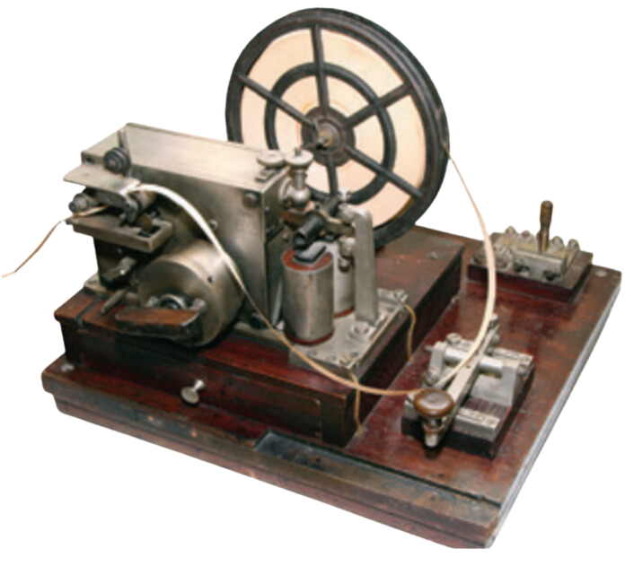


Strand Two & Three: The History of the World
Chapter Thirty-Three: Patterns of Change in Technology
Diagram taken from Artefact, 2nd Edition by Eimear Jenkinson and Gregg O'Neill (educate.ie)
@MsDoorley

Slide 53
The Space Race
Throughout the Cold War, both the US and the Soviet Union spent huge sums of money on scientific research. This arms race led to the development of more powerful nuclear weapons, as well as more deadly aircraft, tanks and naval vessels. In particular, the superpowers invested heavily in ‘the space race’. The rockets designed to carry satellites (and later astronauts) into space could also be used to carry nuclear bombs to attack the other side. New technology developed during the space race (such as computers) could transform both military and civilian life. The first superpower to achieve these great technological feats would prove its superiority.
On the 4th October 1957, the Soviets launched the world’s first satellite, Sputnik. The US became concerned that there was now a ‘missile gap’ between them and the Soviets. In December 1957, the first US satellite, the Vanguard, exploded on the launch pad. The US eventually launched the Explorer satellite successfully on the 1st February 1958.
On the 12th April 1961, Yuri Gagarin of the Soviet Union was the first man in space after he orbited the Earth and returned safely. In February 1962, the US sent a man into orbit when John Glenn piloted the Friendship 7. US President John F Kennedy was determined that the US must succeed in landing a man on the moon by the end of the decade – but he would not live to see it.
Strand Two & Three: The History of the World
Chapter Thirty-Three: Patterns of Change in Technology
@MsDoorley

Slide 54
The Moon Landings and its Impact
The US National Aeronautics and Space Administration (NASA) launched the Gemini and Apollo missions. The Saturn V rocket was built to carry the Apollo spacecraft out of Earth’s orbit. On the 16th July 1969, Apollo 11 launched from Florida carrying astronauts Neil Armstrong, Edwin ‘Buzz’ Aldrin and Michael Collins. On the 20th July 1969, Armstrong & Aldrin landed the lunar module, the Eagle, on the moon’s surface. A camera in the Eagle provided live coverage. Over 500 million people around the world tuned in to make this the most watched event in television history up until that point.
By landing people on the moon, the US had ‘won’ the space race, and with it a propaganda victory over the Soviet Union and communism as a system. The lunar landings continued until 1972, when they lost public support due to high costs. Satellite, communication and computer technologies advanced greatly as a result of technological breakthroughs arising from the space race.
Strand Two & Three: The History of the World
Chapter Thirty-Three: Patterns of Change in Technology
@MsDoorley

Slide 55
Questions Pg 406 (Artefact, 2nd Edition)
  Explain the relationship between population growth and agricultural production.
  In your opinion, what was the most important agricultural innovation of the twentieth century? Give reasons for your answer.
  Why was the internal combustion engine such an important invention?
  How did life change as a result of the work of Edison and Tesla?
  Name one major technological innovation from (a) World War I and (b) World War II.
  How can warfare lead to technological innovations?
  How did twentieth-century wars lead to (a) passenger aircraft; (b) a man landing on the moon and (c) different types of electricity production?
  Who invented (a) the telegraph and (b) the telephone?
  How did these impact people's lives?
  How did television contribute to change in the twentieth century?
  How did World War II contribute to navigational technology? What was the impact of these innovations?
  Why were satellites important in developing navigational systems from the 1960s onwards?
Strand Two & Three: The History of the World
Chapter Thirty-Three: Patterns of Change in Technology
@MsDoorley

Slide 56
1.5 mya - Present
Chapter 33
33.6: SUMMARY
33.6: summary
Strand Two & Three: The History of the World
@MsDoorley

Slide 57
In this chapter, we have learned that...
  Technological innovation has been central to human development throughout history. It caused huge changes to how we have lived.
  In Ancient Times, technological innovations were relatively basic but vital. The invention of the wheel and basic agricultural tools allowed societies to transition from nomadic life to settled communities. These early technologies set the groundwork for more advanced innovations to follow.
  During the Middle Ages, technology evolved slowly but surely. The water wheel and windmill became foundational sources of renewable energy. Metalworking enabled improved armours and weapons, while the late medieval invention of the printing press revolutionised the spread of information.
  In the Renaissance Era, a flurry of technological innovation was spurred by a revival of scientific inquiry. Developments like the telescope and microscope facilitated groundbreaking discoveries in fields ranging from medicine to astronomy, challenging existing beliefs and theories.
  During the 18th and 19th Centuries, the Industrial Revolution dramatically altered technology and society. Steam engines, railways, and the concept of mass production revolutionised transport, communication, and manufacturing, fostering unprecedented social and economic changes.
  In the Twentieth Century, technology rapidly advanced, affecting nearly every aspect of life. Developments like the internal combustion engine and artificial fertilisers enhanced agriculture. Telecommunications evolved substantially, and the Space Race symbolised the peak of technological and ideological competition.
Strand Two & Three: The History of the World
Chapter Thirty-Three: Patterns of Change in Technology
@MsDoorley

Slide 58
Reflecting on... Patterns of Change in Technology
Looking back on the past, we can see that the crucial points that have reshaped human life and changed the course of our history are not often a particular battle or the life of one great leader - but rather innovations, many of which seemed minor or even fantastical at the time. History is driven by innovations, big and small, which can completely remake lives from one generation to the next.
Strand Two & Three: The History of the World
Chapter Thirty-Three: Patterns of Change in Technology
@MsDoorley

Slide 59
Examination Questions
Strand Two & Three: The History of the World
Chapter Thirty-Three: Patterns of Change in Technology
@MsDoorley

Slide 60
Project
Guidelines:
  Length: The depth of your project should reflect about 2-3 weeks of work.
  Sources: Use at least three different sources for your research. These can be books, scholarly articles, or reputable online resources.
  Citations: All information and images that are not your own should be properly cited.
  Mediums: You may choose to present your project in one of the following ways:
    Poster: Your poster should be informative and visually engaging.
    Minecraft or Lego Model: If choosing this option, please also include a brief report explaining your model.
    Painting/Drawing: Your artwork should be accompanied by a description.
    Recycled Materials: Create your model using recycled materials and provide an explanation of your creative process.
Assessment:
Your projects will be assessed based on:
  Research and Content
  Creativity and Presentation
  Understanding of Context
  Adherence to Guidelines
Strand Two & Three: The History of the World
Chapter Thirty-Three: Patterns of Change in Technology
@MsDoorley

Slide 61
Project
Historical Sites
Historical Figures
Bell Labs, Murray Hill, New Jersey, USA
Xerox PARC, Palo Alto, California, USA
CERN, Geneva, Switzerland
IBM Headquarters, Armonk, New York, USA
Silicon Valley, California, USA
James Watt
Henry Ford
Thomas Edison
Johannes Gutenberg
Ada Lovelace
Alexander Graham Bell
Guglielo Marconi
Josephine Cochrane
Grace Hopper
Hedy Lamarr
Steve Jobs
Strand Two & Three: The History of the World
Chapter Thirty-Three: Patterns of Change in Technology
@MsDoorley

